Slide 1
Is there life after Trump
St Michael’s Lecture
16 May 2017

Slide 2
Joseph Camilleri’s website
www.josephcamilleri.org

Slide 3
Rise of Xenophobic Populism
This has become a defining feature of political life in much of the Western world – though it is by no means confined to the Western world.
It manifests itself in the rise of new far right political parties whose messages resonate with the fears and insecurities of a significant cross-section of society.
It infects established political parties which find it necessary to give voice to, or at least turn a blind eye, to xenophobic and scapegoating discourse and policies.
It lowers the tone of the national conversation, places further obstacles in the path of effective citizenship and creates fertile ground for demagoguery of various kinds.

Slide 4
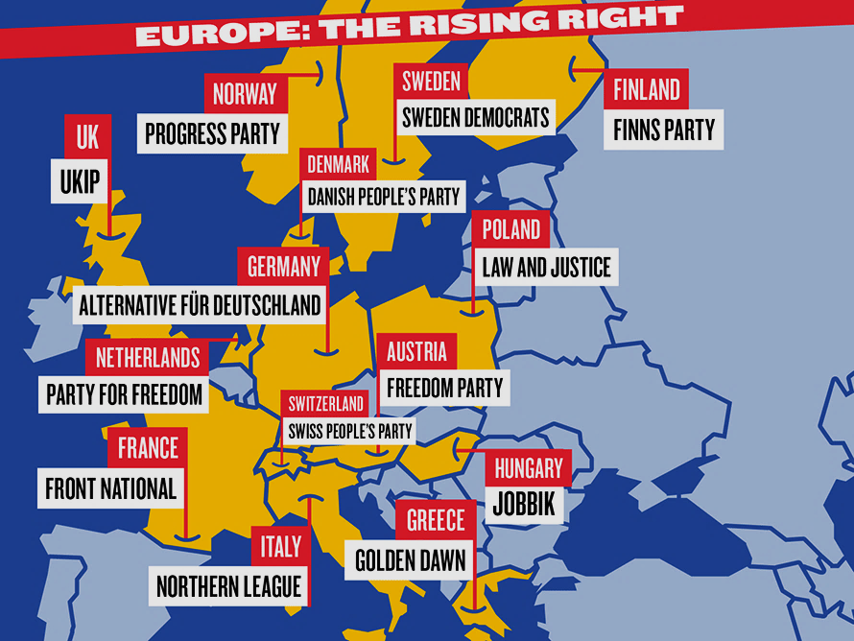

Slide 5
Germany Alternative für Deutschland
AfD has gained representation in ten of the 16 German state parliaments since September 2016.
Started with strong opposition to the European project.
Anti-Muslim focus has now become dominant plank of its platform.
Party’s spring conference adopted the slogan “Islam is not a part of Germany”.
Senior AfD politicians have made speeches urging Germany to stop atoning for Nazi crimes.

Slide 6
Hungary Jobbik
The nationalist “Movement for a Better Hungary” is the country’s third-largest party
In the 2014 parliamentary elections it won a crucial by-election against the right-wing ruling party, Fidesz.
It is trying to improve its image by repackaging itself as a “people’s party”, but it has not shed preoccupation with Hungarian ethnicity, antisemitism and hostility towards Israel.

Slide 7
France Front National
Under Marie Le Pen its political fortunes have reached a new high over the last two years.
Anti-immigration rhetoric brought the FN huge gains in the 2015 local elections – it came first in six of France’s 13 regions, beating the two main parties.
In the recent presidential elections, Marie Le Pen came second n the first round with over 21% of the vote, and in the deciding round received 34% of the vote.

Slide 8
Greece Golden Dawn
Golden Dawn use Nazi-style symbolism and have expressed admiration for Hitler’s regime.
Their leader Nikolaos Michaloliakos called the gas chambers “a lie”
Exploiting deep discontent with austerity and the migration crisis, Golden Dawn came third in Greece’s September 2015 election, winning 7% of the vote. Its spokesman Ilias Kasidiaris, who wears a swastika tattoo, declared: “Golden Dawn is a movement of power; it is not a protest movement any more.”

Slide 9
Austria Freiheitliche Partei Österreichs
Last December FPÖ leader Heinz-Christian Strache narrowly lost Austria’s rerun presidential election to the Greens’ Alexander van der Bellen in December – 48.3% to 51.7%.
In January Strache travelled to Trump Tower to congratulate the new US president and had a meeting with Donald Trump’s then national security adviser, Mike Flynn.
Accused of Nazi sympathies, the FPÖ is vocally anti-Islam, and has called for ‘zero’ immigration..
FPÖ holds 38 of the 183 seats on Austria’s National Council.

Slide 10
Finland The Finns
True Finns almost overnight became the third-largest party in Finland in 2011, wining 39 of the 200 seats in parliament, having won only 5 in the 2007 election.
Now known as The Finns, they have become the second-largest party in parliament in 2015 and have joined the current coalition government.
Led by Timo Soini, The Finns are critical of the European project and anti-globalist.

Slide 11
Sweden Sweden Democrats
The Sweden Democrats emerged from the white supremacist movement, and are now the third-largest party in the Swedish Riksdag, with 49 seats and 12.9 per cent of the national vote.
The party is currently polling second to the governing Social Democrats, at 21.5% – on a par with the centre-right Moderate Party.
They work alone as an opposition party, because mainstream political groups refuse to co-operate with them.
Their leader, Jimmie Åkesson, 37, frequently resorts to anti-immigrant rhetoric and has expressed admiration for Donald Trump.

Slide 12
Denmark Danish People’s Party
The Danish People’s Party (DPP) became the second-largest party in Denmark in the 2015 general election, winning 21% of the vote, up from 12 per cent in 2011.
The DPP has called for cuts to immigration from Muslim countries and withdrawal from the EU’s Schengen free-movement area. It supports a strong welfare state.

Slide 13
The Netherlands Partij voor de Vrijheid
The Dutch nationalist, anti-Islam Party for Freedom (PVV) made its presence felt in the 2006 election in 2006, gaining a greater share of seats in the House of Representatives than other more established parties. In 2012 it came third.
In this year’s March election, the PVV did not do as well as expected, but nevertheless came second, gaining 20 seats.
PVV is an anti-EU, anti-immigration, anti-Islam party.
Its leader Geert Wilders has been described as “the man who invented Trumpism”.
The PVV is already an influential force in Dutch politics, with the governing right party itself adopting ethno-populism rhetoric, especially over immigration and terrorism.

Slide 14
United Kingdom UK Independence Party
UKIP = Eurosceptic and right-wing populist political party
= most vocal political force calling for the UK's exit from the EU
= advocates a drastic lowering of immigration into the UK
= opposes multiculturalism, and promotes a unitary British identity.
UKIP’s share of the vote in European elections:
1999 7%
  2004 16%
2009 16.5%
2014 27.5%
Recent polls suggest Labour may be trailing UKIP among working-class voters

Slide 15
Australia One Nation
Hansonism (= a trend that encompasses a string of other far-right parties, movements and Senate candidates) = cumulative impact of several interlinked factors:
 Islamophobia
Fear generated by long-running “war on terror”
Boat people & ‘border protection’
2016 federal election saw the re-emergence of One Nation Party (ONP) as a considerable force in Australian politics
  In QLD (Senate): ONP outpolled The Greens 9.15%to 7.57%.
  One Nation vote = higher in areas with more Australian-born voters (areas with fewer migrants), in disadvantaged rural and regional communities, and more generally in areas with lower levels of tertiary education
Disadvantaged communities showed stronger support for One Nation
One Nation scored less than 1% of Senate vote in the suburb of Lakemba, where Muslims = some 52% of the electorate) compared to 4.1% for the state as a whole.

Slide 16
United States Trumpism
The trends we have observed in Europe and Australia have not spared America.
The particular circumstances may be different, but the same dynamic is at work:
Anger, resentment, anxiety about an increasingly uncertain, troubling future
The voters may not have an intellectual understanding of how globalisation works, but many have personal experience of the ravages wrought by neo-liberal policies and institutions.
And so voters become highly susceptible to messages that challenge the establishment, elites, and globalisation, and make convenient scapegoats of the weak and the vulnerable.
In essence this is Trump’s message as it is that of Gert Wilders and Marie Le Pen .

Slide 17
More Promising Pathways
Place reduction of economic inequality at the heart of the national/ international conversation & political agenda.
Develop a global approach to global problems – especially those that pose an existential threat to humanity.
Small & middle powers to exercise collective leadership in developing the principles and practice of “International Good Citizenship”
Nurture active, informed citizenship
Give new life and content to Multiculturalism

