Slide 1

America, Russia and China
An unholy trinity
of ego, power and mistrust

Slide 2
Expansion of NATO
https://www.youtube.com/watch?v=sya1eYhqBiA

Slide 3
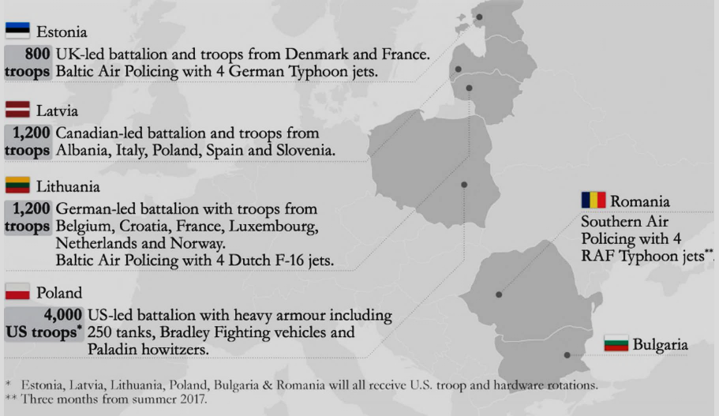
NATO’s Military Buildup in Eastern Europe

Slide 4
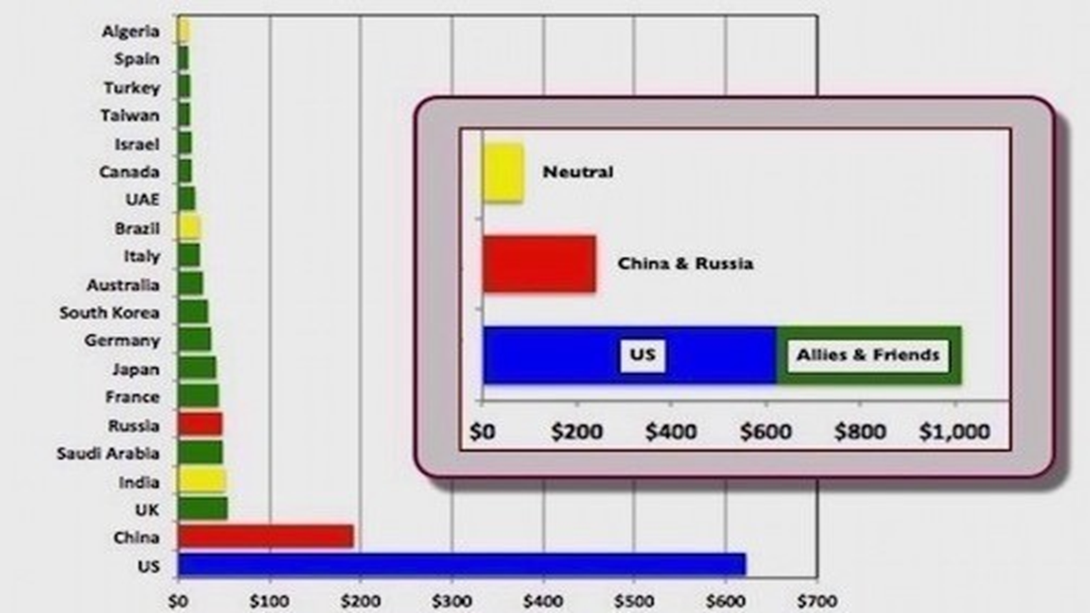
World Military Spending
Top 20 Countries 2016 (constant 2016 $billion)
Jane’s Database 2016

Slide 5
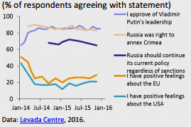
Russian Public Opinion on Sanctions

Slide 6
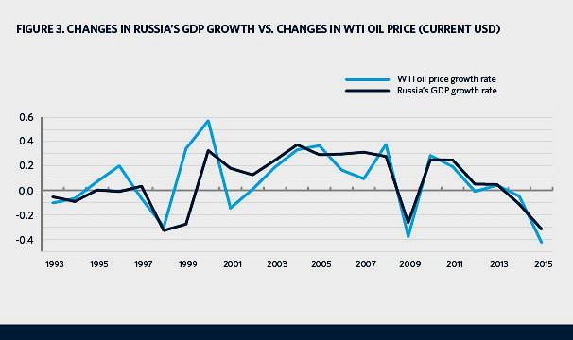
Russia’s Annual GDP Growth rate vs Price of oil (current US$)

Slide 7
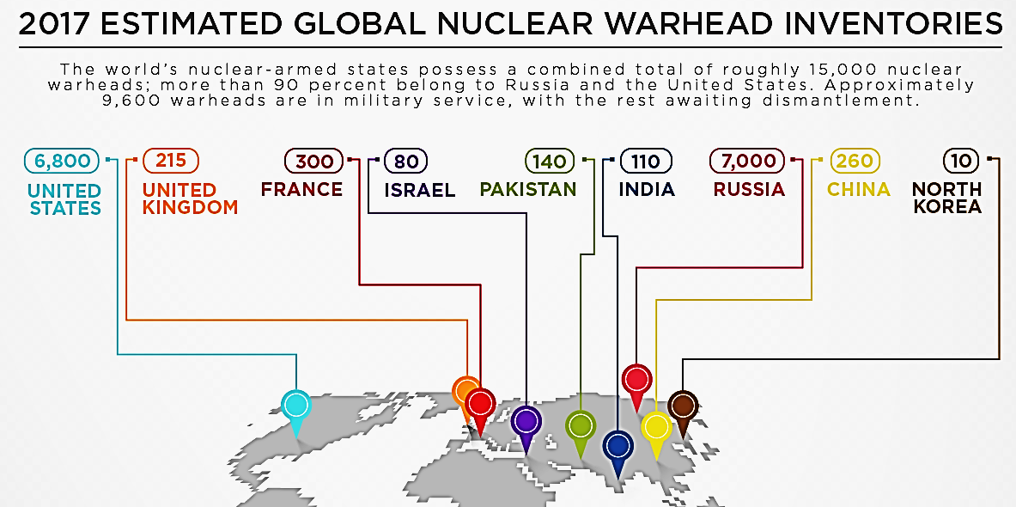

Slide 8
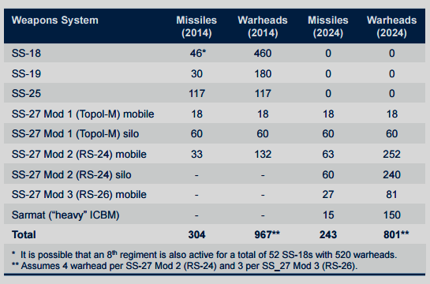
Russia – ICBM Modernization

Slide 9
China – Economic Superpower
2007-2016: China’s private consumption grew average annual rate of 8.9%
(1.6% growth in US)
China = largest mobile phone network with 1.3 billion mobile phone subscribers (June 2016).
China’s e-commerce sales (2015) = $672 billion (nearly double US level). Projected sales likely to surge to nearly $2 trillion by 2019.
China replaced the United States as the world’s largest Internet user in 2008. As of June 2016, China had an estimated 721 million Internet users, double the number in the US.
According to estimates by Credit Suisse (a global financial services company), in 2015 China overtook the US to become the country with the largest middle class at 109 million adults (with wealth between $50,000 and $500,000); the U.S. level was estimated at 92 million.

Slide 10
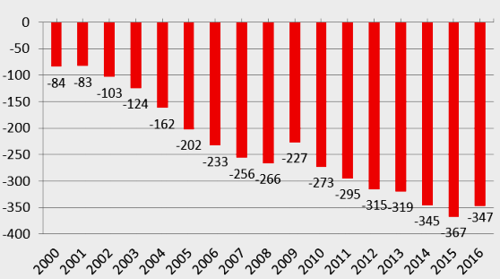
China – US Economic Relations
US FDI in China (stock) was $74.6 billion in 2015 up by 10.5% from 2014 – primarily in manufacturing, wholesale trade, and depository institutions.
China's FDI in US was $14.8 billion in 2015 - up 50.6% from 2014.
2016: U.S. total trade with China = $648.2 billion
Exports = $169.3 billion Imports = $478.9 billion
US trade deficit with China = $309.6 billion
US
Goods
Trade
Deficit
2016
$347 billion

Slide 11
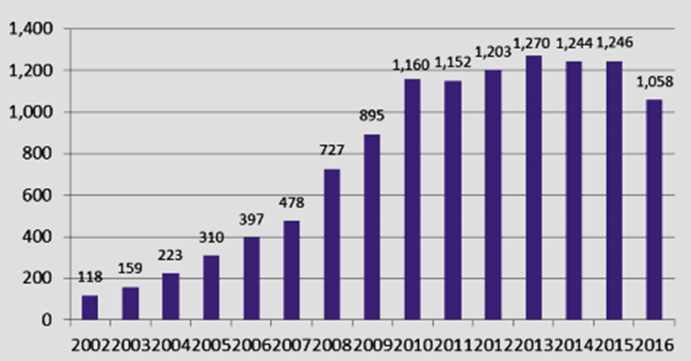
China’s holdings of US Treasury Securities
2002-2016 (in $billion)

Slide 12
China – US Economic Relations
In 2015, 2.6 million Chinese visitors to US (up 18.3% from 2014 over the previous year). By 2020, this figure will rise to 5.0 million.
Boeing Corporation delivered 145 planes to China in 2015. Boeing predicts that over the next 20 years (2015-2034), China will need 6,330 new airplanes valued at $950 billion, and will be Boeing’s largest commercial airplane customer outside the United States.
General Motors (GM) reports that it has sold more cars and trucks in China than in the United States each year for the last seven years. In 2016, GM sold 3.9 million vehicles to China, compared to 3.0 million vehicle sales in the US.
A January 2017 study prepared by Oxford Economics estimates that US exports of goods and services to China, plus bilateral FDI flows, directly and indirectly supported 2.6 million US jobs and contributed $216 billion to US GDP.
It predicted US exports of goods and services to China would exceed $520 billion by 2030.

Slide 13
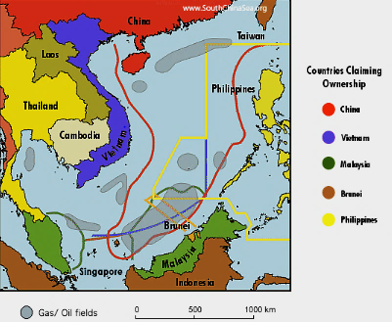
South China Sea Territorial Disputes

Slide 14
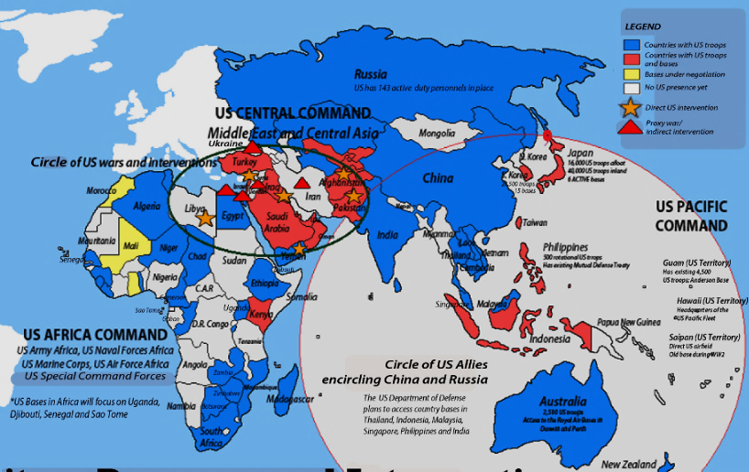
US Military Presence in Asia & Middle East

