Slide 2
Risks & Opportunities A World in Ferment
Risks & Opportunities A World in Ferment
State of the Nation

Slide 3
Josephcamilleri.org

Slide 4
The Enigma that is Australia
Speaking in October 1939, Churchill described Russia as
“a riddle wrapped in a mystery inside an enigma”
An apt description of Australia.
Churchill went on to say:
“ But perhaps there is a key. That key is the Russian national interest”
The national interest is certainly not the key to the Australian enigma.
So where might we find the key?

Slide 5
The Enigma that is Australia
Different writers have pointed to different keys:
Distance and isolation
Geoffrey Blainey The Tyranny of Distance: How Distance Shaped Australia's History (1966)
Mediocrity and parochialism
Donald Horne The Lucky Country (1966)
“Australia is a lucky country run mainly by second rate people who share its luck. It lives on other people’s ideas, and, although its ordinary people are adaptable, most of its leaders (in all fields) so lack curiosity about the events that surround them that they are often taken by surprise.”

Slide 6
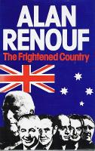
The Enigma that is Australia
Fun and Games
David Mosler Australia, the recreational society (2002)
“A recreational society is one that is dedicated to pleasure and hedonism and determined to maintain most of its population in an adolescent state. In a recreational
society, the basis of national policy formulation never confronts
directly issues of national independence: the economy, defence policy, national goals, and identity are kept within a dependency framework.”
Fear
Alan Renouf The Frightened Country (1979)

Slide 7
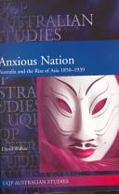
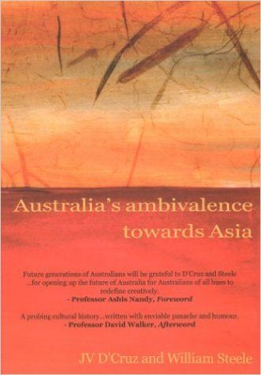
The Enigma that is Australia
Anxiety
David Walker Anxious Nation: Australia and the Rise of Asia, 1850-1939 (1999)
Ambivalence / Racial Divide
JV D'Cruz and William Steele Australia's Ambivalence towards Asia: Politics, Neo/Post-Colonialism, and Fact/Fiction (2003)

Slide 8
Australia: A Progressive Nation
Social and economic reforms:
The first Trades & Labour Council is formed in New South Wales (1871).
The first comprehensive legislation on working conditions is enacted (1896).
The Early Closing Act restricts the length of working hours (1899).
The Truck Act 1900 requires the payment of wages in money, and prohibits employers from influencing how employees spent wages.
The Industrial Arbitration Act, the first 'modern' industrial relations statute, comes into force in December 1901.
A basic or minimum wage is set for male employees (1907).
Wages Boards are created to set pay and conditions across all industries.
The Eight Hours Act creates a standard 48 hour working week (1916).
A basic female wage is established (1919).

Slide 9
Australia: A Progressive Nation
Political Reforms
In 1843 the first colony-wide election is held in New South Wales followed by Victoria, Tasmania and South Australia in 1851.
In 1894 South Australia gives women the vote and the right to stand for parliament.
The Australian Senate is the first popularly upper house in the world.
In 1902 women gain the right to vote and stand for federal parliament, making Australia the first country in the world to do so nationally.
In 1904 Australia elects the first national labour government in the world.
By 1908 women can vote in all State elections as well as federally.

Slide 10
Race, Anxiety & Dependence
Impact of history and geography
Perceived need for protection
Loyalty to the protector
Relationship with Asia: problematic

Slide 11
Contemporary Symptoms of Anxiety
Anzac story
Boat people
Counter-terrorism
Relationship with Indigenous Australia

Slide 12
Contemporary Challenges: Global Context
Engaging with Asia
Ending dependence on ‘Great and Powerful Friends’
Rethinking Australia's place in the world

Slide 13
Contemporary Challenges: Domestic Context
Democratising our politics
Constitutional change
Reforming party politics
Civic engagement
Democratising the economy
Reducing inequalities
Democratising the workplace
Rethinking the role of education
Reimagining Multicultural Australia

