Slide 1
Make Australia Great Again, or Make the Planet Great Again
Is it one or the other, or both or neither?
St Michael’s Lecture
5 September 2017

Slide 2
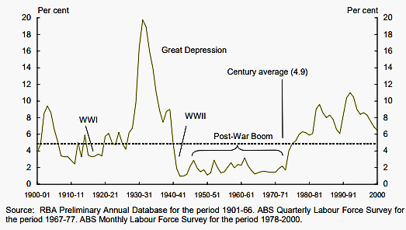
Australia’s Unemployment Rate 1901-2000

Slide 3
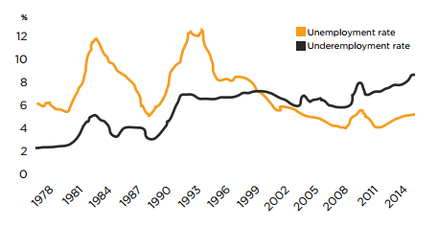
UNDEREMPLOYMENT & UNEMPLOYMENT
Source: ABS (2016

Slide 4
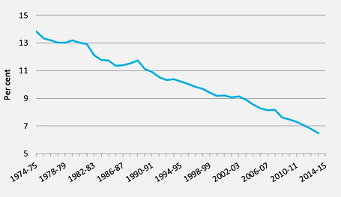
Manufacturing Industry’s Share of GDP

Slide 5
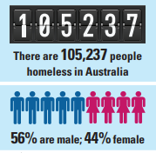
Homelessness
On any given night in Australia 1 in 200 people are homeless.
255,657 people received support and almost 7,000,000 nights of accommodation were provided by specialist homelessness services in 2014-15.

Slide 6
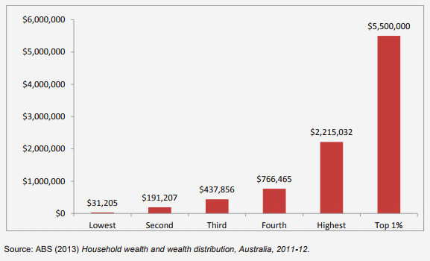
Australian Wealth Inequality

Slide 7
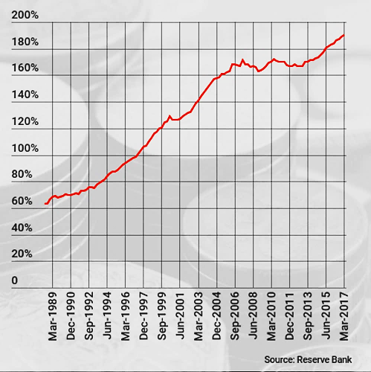
Household Debt Compared With Annual Income

Slide 8
Australia’s Progressive Past
Australia pioneered many internationally significant social and economic reforms: :
The first Trades & Labour Council is formed in New South Wales (1871).
The Trade Union Act recognises NSW trade unions for the first time as distinct corporate organisations (1881).
The first NSW Government agency is established to deal with employment-related issues (1892).
Comprehensive legislation on working conditions in factories, shops and other industrial establishments is enacted - working hours of women and children are restricted (1896).
The Early Closing Act 1899 restricts the length of working hours for all employees

Slide 9
Australia’s Progressive Past
The Truck Act 1900 requires the payment of wages in money, and prohibits employers from influencing how employees spend wages.
The Industrial Arbitration Act 1901, 1st 'modern' industrial relations statute, comes into force in December 1901. Separate arbitration court is established, with binding powers.
The Apprentices Act 1901 reduces hours of apprentices to a maximum of 48 per week.
A basic or minimum wage is set for male employees (1907).
The Industrial Disputes Act 1908 introduces ‘Wages Boards’ that can determine pay and conditions across all industries.
The Eight Hours Act 1916 creates a standard 48 hour working week.
A basic female wage is established (1919).

Slide 10
Australia’s Progressive Past
The first colony-wide election is held in New South Wales (NSW) in 1843 and is followed by Victoria, Tasmania and South Australia in 1851.
By 1856 all four colonies achieve responsible government through the creation of new bicameral parliaments and governments answerable to the lower house.
In 1894 South Australia gives women the vote and the right to stand for parliament.
IN 1901, the Federation is established by the peaceful coming together of six colonies.
Federation makes the Australian Senate the first upper house in the world to be popularly elected.
The Commonwealth Electoral Act of 1902 gives women the right to vote and stand for federal parliament, making Australia the first country in the world to entrench both rights nationally.
By 1908 women can vote in all State elections as well as federally.

Slide 11
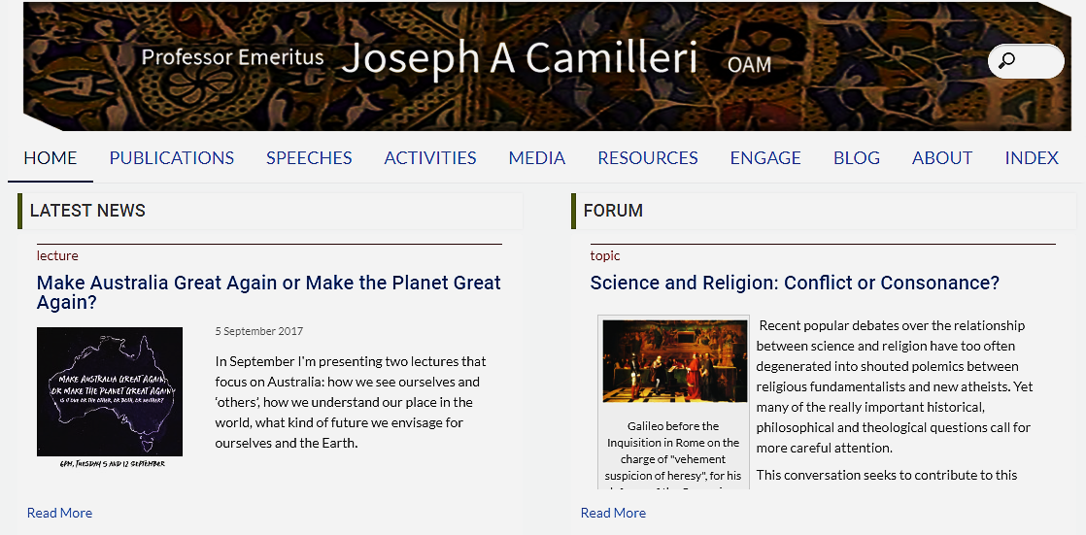
Joseph Camilleri’s website www.josephcamilleri.org

