Slide 2
Risks & Opportunities A World in Ferment
Risks & Opportunities A World in Ferment
The Democracy Deficit

Slide 3
Resources
www.Josephcamilleri.org
www.resourcesforemocracy.com/
www.opendemocracy.net
www.transparency.org

Slide 4
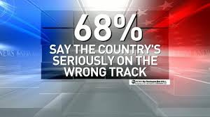
Winter of Discontent
In much of the Western world – Australia
included – public discontent is on the rise.
People are disillusioned with:
Juvenile shadowboxing in our parliaments
Spin – designed to conceal weakness or evade criticism
Short-termism of government ➔ political failure complementing market failure
Political corruption
Money politics

Slide 5
Winter of Discontent
Many feel disconnected from the political process:
Unable to influence decision making
Unable to access relevant information
Unable to get a sense of the nature or scale of the problem
Unable to grasp the options available to them
Unconvinced that those vying for political office are themselves equipped to handle the challenges we face.
DEMOCRACY DOES NOT SEEM TO BE WORKING

Slide 6
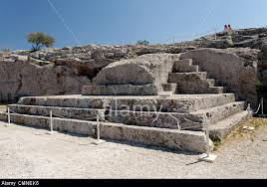
Back to Basics: What is Democracy
We have had several expressions of the democratic ethic.
Perhaps the first and most challenging example:
Indigenous systems of law and consensual decision making
Athenian model:
Democracy (dēmokratia) derives from dēmos, which refers to the entire citizen body, and kratos, meaning rule.
Any male citizen could participate in the main democratic body of Athens, the assembly (ekklēsia), which met at least once (more often 2 or 3 times) a month – excluded were women, slaves and foreigners.
In the 4th and 5th centuries BCE the male citizen population of Athens ranged from 30,000 to 60,000 depending on the period.
The assembly met on the Pnyx hill in
a dedicated space which accommodated
around 6000 citizens.
Nine presidents (proedroi), elected by lot and holding the office one time only, organised the proceedings and assessed the voting.

Slide 7
Democracy in the Modern Period
In 18th century Industrial Revolution & Enlightenment ushered in renewed intellectual and political interest in democratic thought.
New concepts of:
political rule
social contract
legitimacy

Slide 8
Foundational Principles of Democracy in the Modern Period
Key principles (enunciated by leading thinkers though with considerable differences among them, e.g. Rousseau, John Stuart Mill):
Political Equality – all citizens have an equal voice in all decisions made in the public sphere (i.e. decisions made by public institutions)
. . . no citizen shall be rich enough to buy another and none so as to be forced to sell himself. (Rousseau)
Responsible citizenship (i.e. citizens consider the public interest and not just their own private interests) ➔ greater sense of belonging to community.
Participation ➔ development of community
Democratic institutions and processes must promote ‘the advancement in intellect, in virtue and in practical activity and efficiency’ (John Stuart Mill) – they must perform an educative function.
Human beings have a dignity by virtue of being human – and no law can take away that inherenbt dignity or the rights that flow from it. Citizens have entitlements and no majority decision can deprive them of those entitlements.

Slide 9
Democracy in the Modern Period
Over time these principles have been steadily eroded in both theory and practice.
Representative government reduced to a choice between political elites ➔ political parties = machines that operate and benefit from the electoral process
Participation = reduced to periodic elections ➔ the role of citizen reduced largely to that of a spectator
Education for the democratic life = virtually abandoned
Democracy is transformed into a competition between individual and group interests at the expense of community
Sense of identity and belonging come to rest more and more on manufactured (top-down) nationalism and a national security agenda.

Slide 10
Democracy in the Post-Modern World
Over the last several decades additional factors have adversely affected democratic practice
Rise of economic conglomerates with vast budgets that wield undue economic and political muscle
Rise of mass media that exercise a pervasive influence over the substance and tone of political discourse
Development of economic globalisation and more generally cross-border flows which lie beyond the control of any state (➔ transnational challenges to security)
Rise of a global orthodoxy on what constitutes good governance – mediated by major international organisations and internalised by the world’s national bureaucracies
Decline of political parties as agents of political mobilisation and education
Rise of religion & growth of multi-ethnic, multi-faith societies.

Slide 12
Tiers of Governance
Global Organisations
Regional
Organisations
National State
Provincial
Government
Municipality

Slide 13
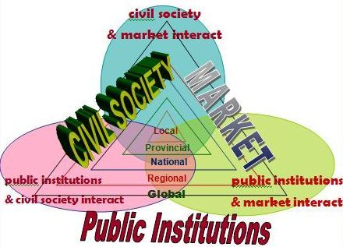
Arenas of Governance

